Slide 1
DataOps
Pravin Y Pawar

Slide 2
Agenda
DataOps
Approach
Foundations and Requirements
Technology Framework
Tools and vendor landscape
Benefits and Pitfalls

Slide 3
DataOps

Slide 4
DataOps
New Approach
Data Analytics pipelines becoming more complex and development teams grow in size
organizations need better collaboration and development processes
to govern the flow of data and code from one step of the data lifecycle to the next
– from data ingestion and transformation to analysis and reporting
DataOps
is an emerging set of practices, processes, and technologies
for building and enhancing data and analytics pipelines
to meet business needs quickly
The goal is to increase agility and cycle times,
While
reducing data defects,
giving developers and business users greater confidence in data analytics output

Slide 5
DataOps(2)
Foundations
Builds on concepts popular in the software engineering field,
such as agile, lean, and continuous integration/continuous delivery
but addresses the unique needs of data and analytics environments,
including the use of multiple data sources and varied use cases that range from data warehousing to data science
Relies heavily on
test automation
code repositories
collaboration tools,
orchestration frameworks
and workflow automation
to accelerate delivery times while minimizing defects

Slide 6
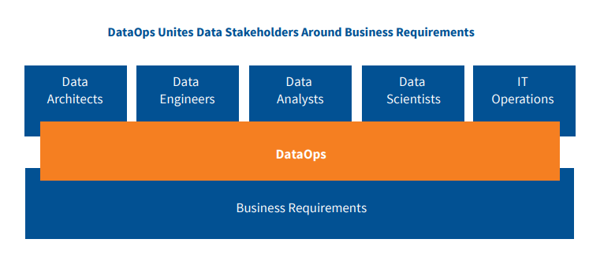
DataOps(3)
Data Stakeholders

Slide 7
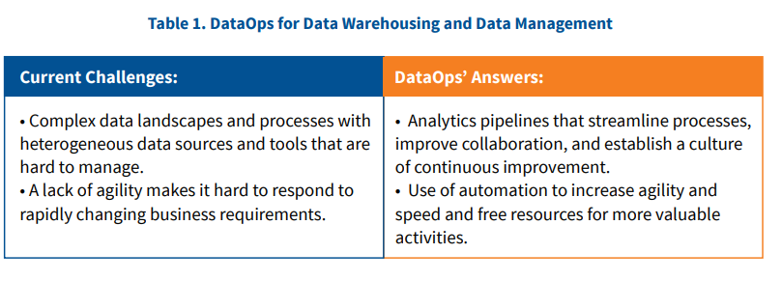
DataOps(4)
DataOps for Data Warehousing and Data Management

Slide 8
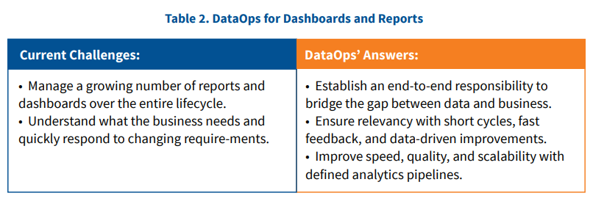
DataOps(5)
DataOps for Dashboards and Reports

Slide 9
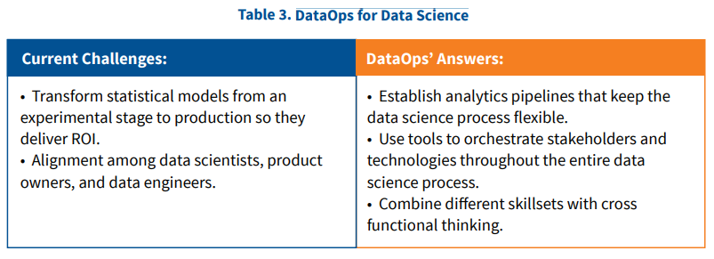
DataOps(6)
DataOps for Data Science

Slide 10
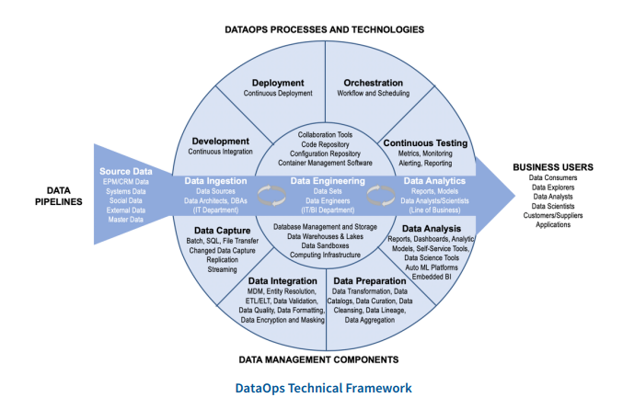
DataOps(7)
Technology

Slide 11
DataOps(8)
Tools
There are five categories of DataOps products on the market today:
All-in-one tools
Orchestration tools
Component tools
Case-specific tools
Open source tools

Slide 12
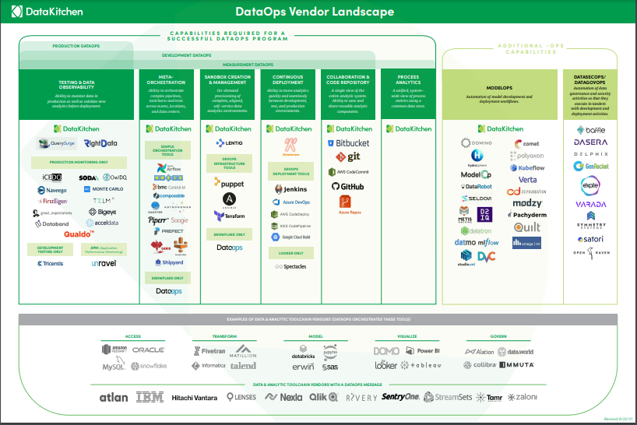
DataOps(9)
Vendor Landscape

Slide 13
DataOps(10)
Benefits of DataOps
Improve Collaboration and Communication
comes with a change in culture that promotes collaboration, trust, and responsibility
goals are to blur the lines between departments and functions,
encourage the exchange of knowledge, reduce conflicts, and eventually increase productivity
Accelerate Time to Production
A major driver for DataOps is speed
Idea of streamlined and largely automated analytics pipelines helps deliver new features and insights quickly and reduces manual effort
Short feedback and testing cycles help speed up reactions to changing business requirements and increase flexibility
Increase Quality and Reliability
Well-defined analytics pipelines enhance both speed and robustness
For instance, multiple stages of automated and manual tests prevent the deployment of flawed updates
Besides, DataOps also includes monitoring of rolled-out changes to identify bottlenecks and potential issues
Lastly, the convergence of different roles helps align changes throughout various stages,
such as when a data engineer is informed about the later cleansing issues encountered by a data scientist

Slide 14
DataOps(11)
Common Pitfalls of DataOps
The following common pitfalls should be considered on the way to a DataOps culture
Acceptance:
Don’t make it technical!
DataOps has the same burden as other related ideas in software engineering, which are often characterized as technical Knick knacks
It is important to show that DataOps is not a technology trend, but a business trend
Communicate the holistic idea of DataOps, get everybody on board early, and show that business value is the goal, rather than having a fancy tech stack
Engineering:
Keep it simple!
DataOps combines many concepts which can be extended almost endlessly, running the risk of over-complication
Always take care to balance effort and benefit
This applies to both technical solutions, such as unnecessary tests and overly complex deployment processes, and to organizational structures, which can easily become burdened with too many roles, feedback loops, and overly rigid processes.

Slide 15
References
The Ultimate Guide to DataOps Product Evaluation and Selection Criteria
DataOps: Industrializing Data and Analytics Strategies for Streamlining the Delivery of Insights
IBM DataOps How and Why Whitepaper

Slide 16
Thank You!

